Slide 1
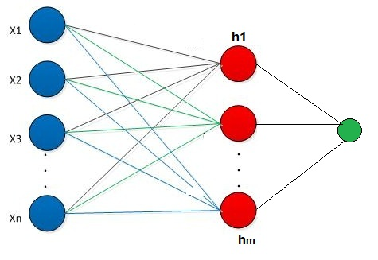
Reinforcement Learning
Josh Moses
October 27, 2018
With thanks to Rania Sharara
This Photo by Unknown Author is licensed under CC BY-SA
Notes:
Rania Sharara designed the graphical layout and aesthetic aspects of the slides for this presentation. Find her at: https://www.upwork.com/o/profiles/users/_~01919c2041661b9e55

Slide 2
Machine Learning
Supervised Learning
Unsupervised Learning
Reinforcement Learning
Regression
Classification
Clustering
Agent interacts with environment

Slide 3
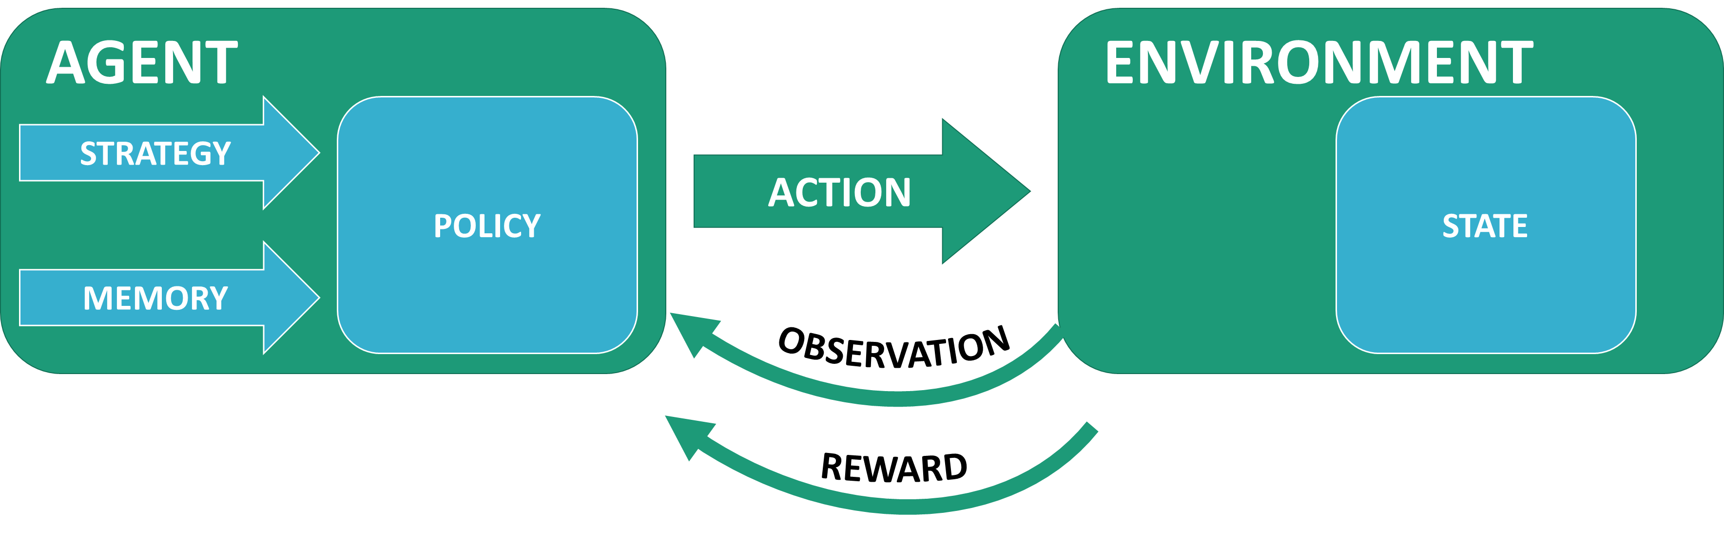
Reinforcement Learning Agent iteratively interacts with environment
AGENT | GOAL | STRATEGY | MEMORY
 | Maximize long-term reward Develop optimal policy | Balance two priorities Take actions expected to produce reward Learn about the environment | Remembering the consequences of past actions allows the agent to learn What actions lead to rewards What actions lead to states that lead to rewards
ENVIRONMENT
Next state is influenced by current state and agent’s action May be deterministic or stochastic Rewards the agent for achieving desirable states
Notes:
Initially, the agent’s memory is empty and an action is taken at random. The observation and action comprise the X values for training, while the reward is used as the Y value. Thus the agent learns to predict the reward for a given action in a given state.

Slide 4
Agent iteratively interacts with Environment
The Agent
The Environment
Acts on the environment
A state machine where the next state depends on the current state and the agent’ next action
Observes the environment’s state
Each state is defined by observable parameters
Receives rewards from the environment for finding desirable states
Desirable states return reward to the agent

Slide 5




Possible future applications of reinforcement learning
A robot could learn to play a sport by being rewarded when it scores points
A robot could learn to clean your house by being rewarded for collecting dirt and trash
A software agent could learn to optimize prices by being rewarded for increasing profits
A software agent could learn to optimize logistics by being rewarded for reducing costs

Slide 6
Reinforcement learning techniques
Temporal Difference Learning
Q-Learning
Deep Q-Learning
Has been successfully applied to the game of backgammon
Tesauro, G. Temporal difference learning and TD-Gammon. Commun. ACM 38, 58–68 (1995).
Estimate the expected outcome value of each possible action, in each possible situation.
http://www.cs.rhul.ac.uk/~chrisw/new_thesis.pdf
Use Q-Learning in a Deep Neural Network
Deep Mind used this method to create a software agent that successfully learned to play Atari games

Slide 7
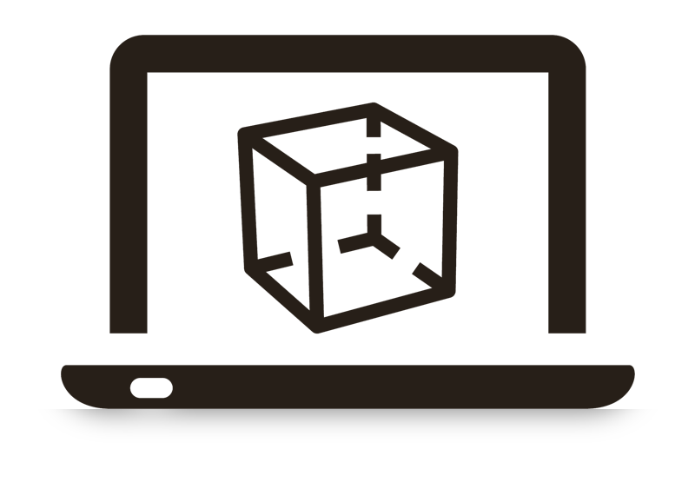
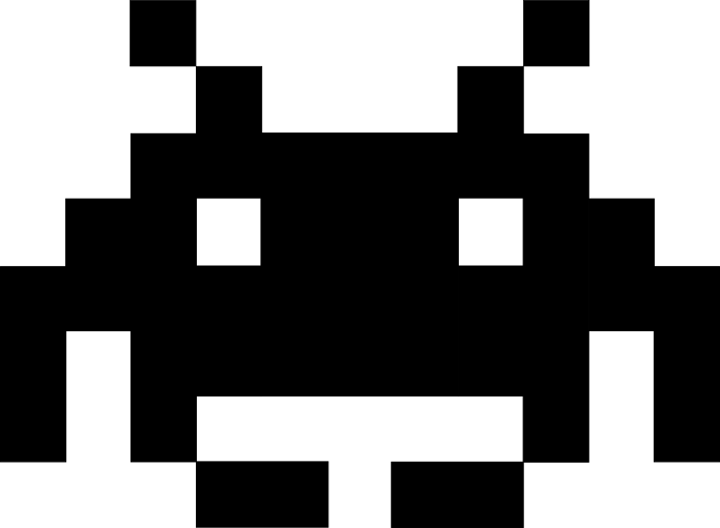
Simulation
Simulated environments can be used to test agents
Computer games offer good examples of simulated environments

Slide 8

References
Sutton, R. & Barto, A. Reinforcement Learning: An Introduction (MIT Press, 1998)
DeepMind's 2013 paper
Nature, 2015
DeepMind's DQN code
OpenAI Gym

Slide 9
Cart-pole solution examples
Many examples of proposed Q-learning solutions to the Open Ai Gym’s Cart-Pole environment are available on GitHub.
They differ in coding structure, but most follow the same basic algorithm
1
2
3
4
5
6
Start by making some moves at random
Record each move, including its state, action, and outcome, including next state and reward, into one big list, regardless of where the move occurred in the game sequence
Use an exponentially decaying epsilon value to, “exploit or explore,” in each step
The cart-pole environment yields a reward of 1 for every move that does not immediately result in dropping the pole
Periodically retrain the agent on a random sample (“minibatch”) of all record results, with no preference for the newest results
The earliest results will have the greatest influence on the model, because they have the greatest opportunity to be repeatedly selected for retraining

Slide 10
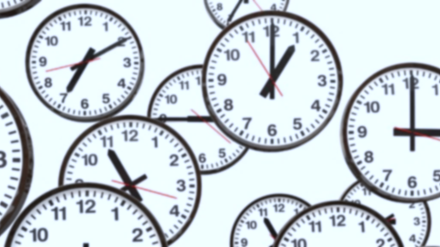
Typical reinforcement learning metric
How long does it take to learn how to perform well?

Slide 11

New Algorithm
1
2
3
4
5
6
Do not blindly record the reward of 1 issued by the cart-pole environment.
Do not record any results until the game (episode) has ended.
Do not record any positive-valued rewards.
Record a reward of $\left(−1\right)$ for the action that caused the pole to drop. Record a reward of $\left(−1\right)∗ γ$ for the second-to last action, a reward of $\left(−1\right)$* $γ$² for the third-to-last action, and so on. Therefore, actions furthest from the final demise of the pole incur the least penalty.
Since no tested actions resulted in positive rewards, the action with the highest predicted reward will be an action that has not been tested. Therefore there is no need to balance the, “Exploit vs. Explore,” tradeoff, as is normally necessary with Q-learning.
After each game (episode), supply its results to the agent as new training data. Retraining on older data is not needed.

